Slide 1





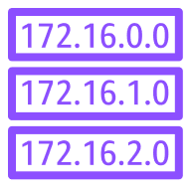

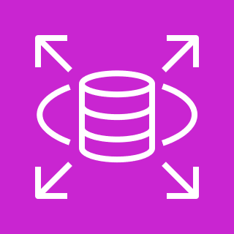
AWS Cloud
VPC
Internet gateway
Public subnet
NAT gateway
Public Route Table
Private subnet
Private Route Table
RDS

